Slide 1
Implementing Lean approach for emergency care at Northeastern’s UHCS
Mufaddal Husain
Aditya Kaspate
Deveeka Ravi Meshram Jainil Jain

Slide 2
Lean approach
Problem Statement:
Northeastern University's UHCS faces issues with long wait times and inefficient urgent care prioritization. This project will introduce visual management tools to streamline patient flow, reduce waits, and improve service quality, enhancing both patient satisfaction and healthcare delivery efficiency.
1. Value Stream Mapping (VSM):
We will use VSM for identifying inefficiencies and enhancing treatment flow through elimination of redundancies.
2. Kanban Systems:
We will apply Kanban for visual patient flow management, prioritizing urgent care and optimizing resource allocation to reduce wait times.
3. Continuous Improvement (Kaizen):
To promote a culture of ongoing improvement through staff and patient feedback, leading to iterative enhancements in service efficiency.

Slide 3
Northeastern’s UHCS Current Emergency Care Flow
Initial assessment
Triage
In-person Evaluation
Diagnostic Tests
Treatment Plan
Monitoring and Follow-up
Referral to Specialist
Documentation and Follow-up Care

Slide 4
Analysis and Goals
What is wrong with the current state
include both documented conclusions and your interpretation
Goal of improvement
More text, or, better, picture conveying topic – current state map would work well here…

Slide 5
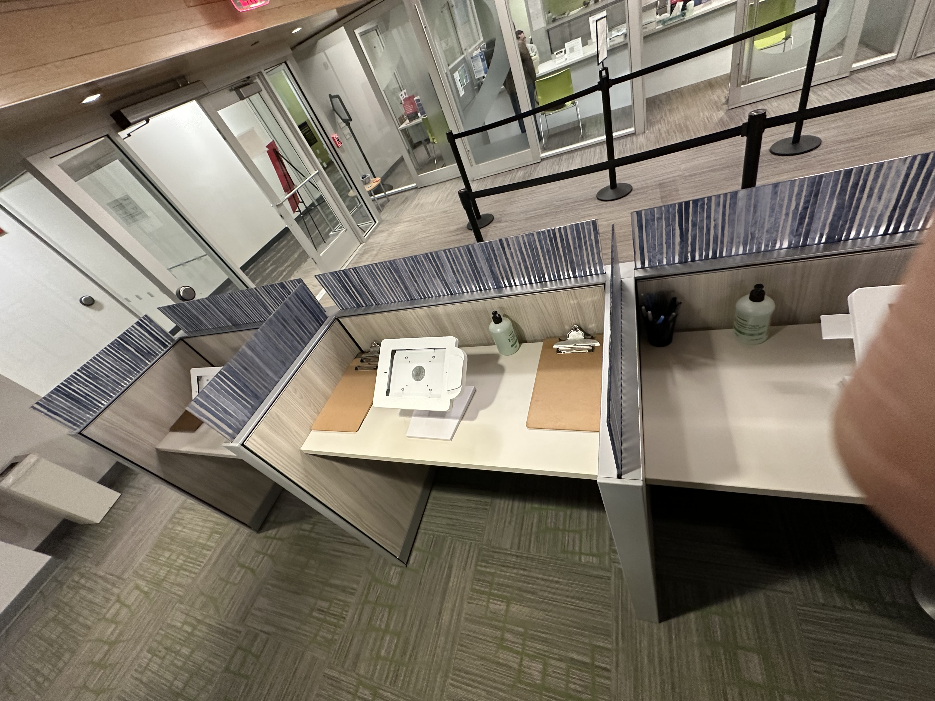
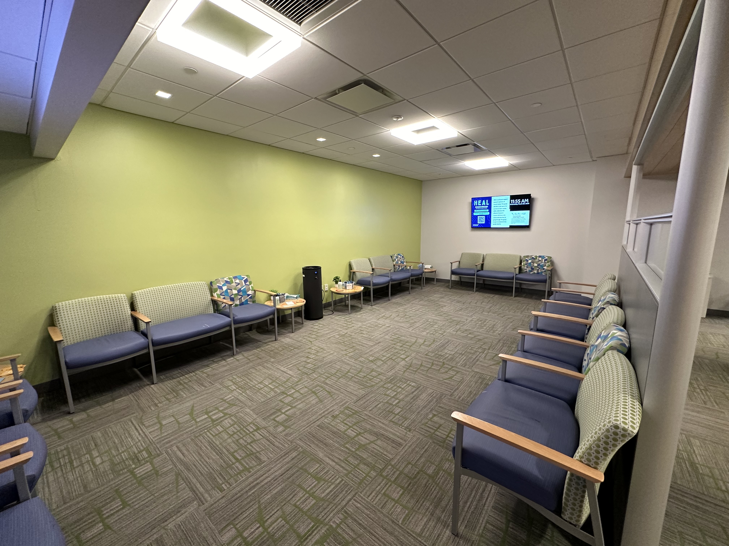
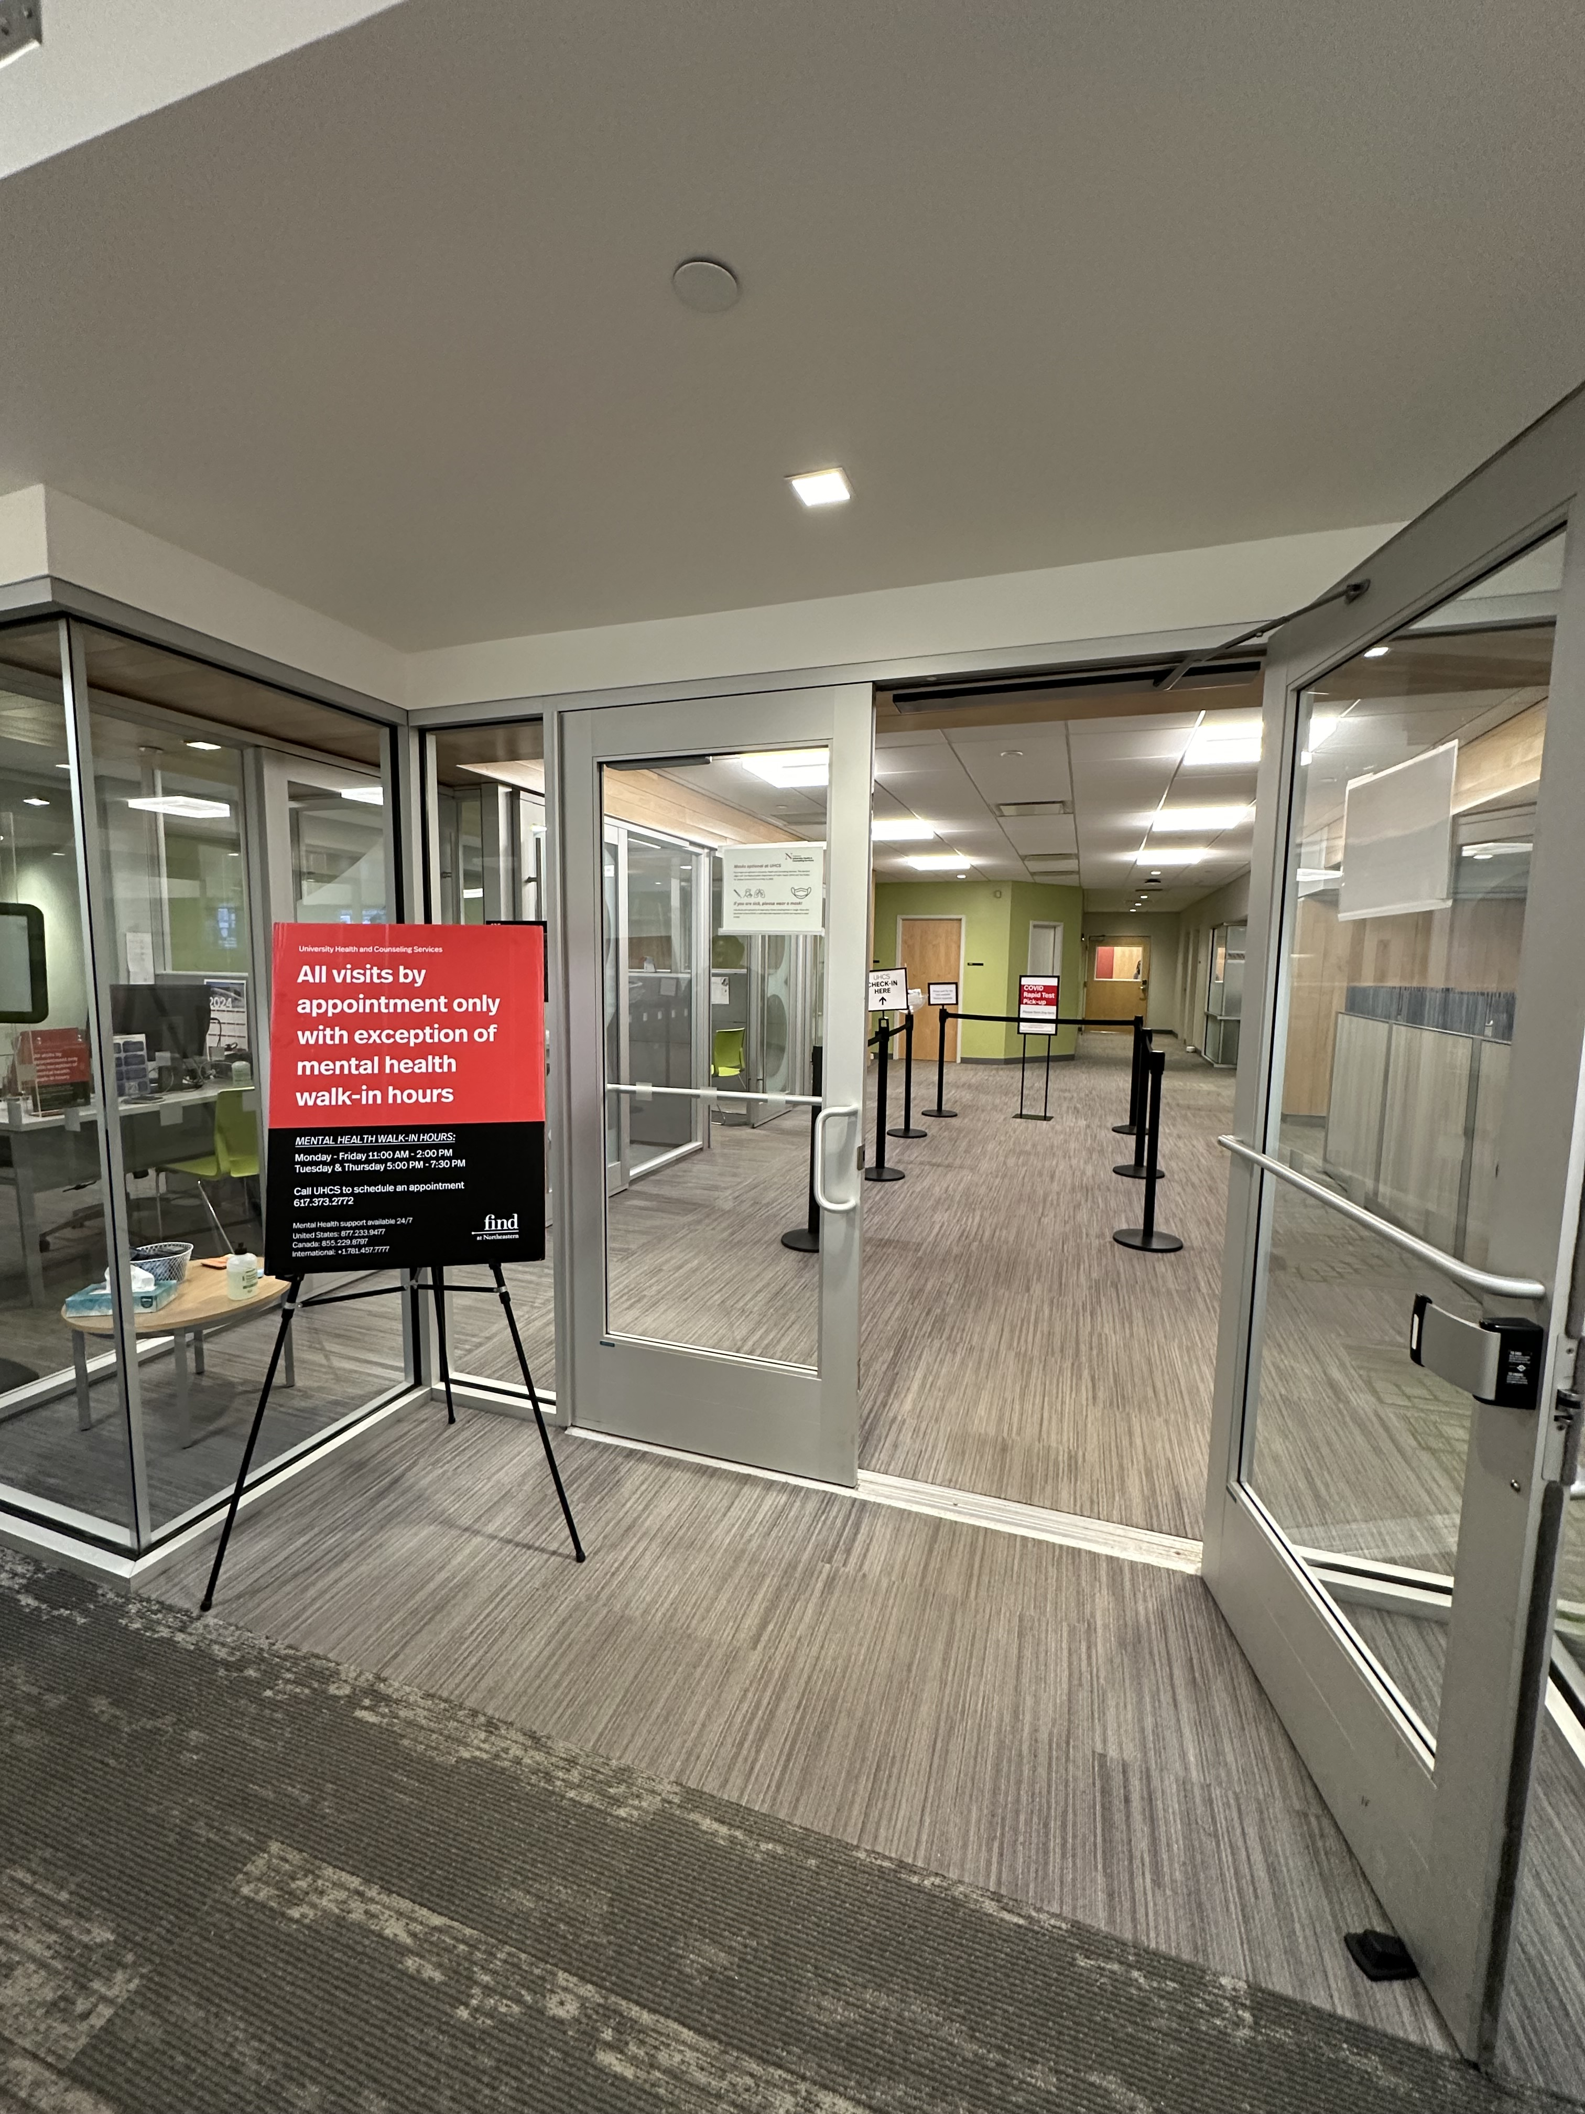

Slide 6
Implementation
What was done!
More text, or, better, picture conveying topic – current state map would work well here…

Slide 7
Follow up
Results of improvements
Next Steps
Lessons Learned
More text, or, better, photo or graphic supporting text

